Slide 1
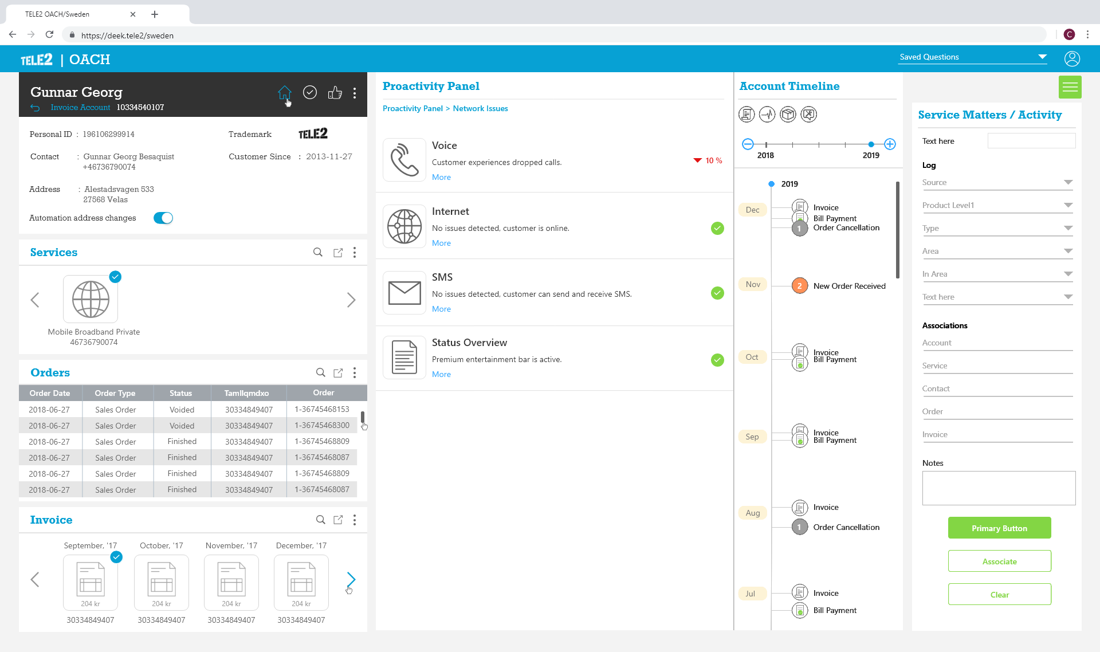
OACH can be de-coupled from Siebel and have its over header with CSR profile info
Clean and sleek iconography with hover and click states
Service log form is simplified with clean UI components and clear call to actions
Each tile can be treated as portlet & option to pop over and expand can be given
Labels and Typography are made consistent everywhere
Account timeline is made vertical to accommodate current events and give a continual feel
Carousal interaction is clear and is active when there are more than 4 items

Slide 2





UX Feature List
Modular Tile layout
Can shuffle the tiles and re-arrange them
Model Windows
Pop over of modules can give a detailed info in the OACH tabs
Basic Tile Interactions
Can move, collapsed and resize based on User preference
Timeline can have infinite scroll with key filters to sort through the events
The zoom function of the timeline will have vertical interaction which is more intuitive and close to real life.
New features which may be need of the future – for e.g. adding trend mapping etc. for a user and having predictive and preemptive approach for better customer services

Slide 3
Flexible and Scalable UI Layout
Fixed Layout (Current)
Scalable Layout (Proposed )
{Customer Information}
{Timeline & Details}
{Service Log}
{Customer Information}
{Details}
{Timeline}
{Service Log}

Slide 4

Here is how scalability works:
Less than100%
100%
OACH with removed timeline
OACH in full scale
~50%
~70%-60%
OACH with details scaled down
OACH with details pane removed

Slide 5
Mock ups

Slide 7
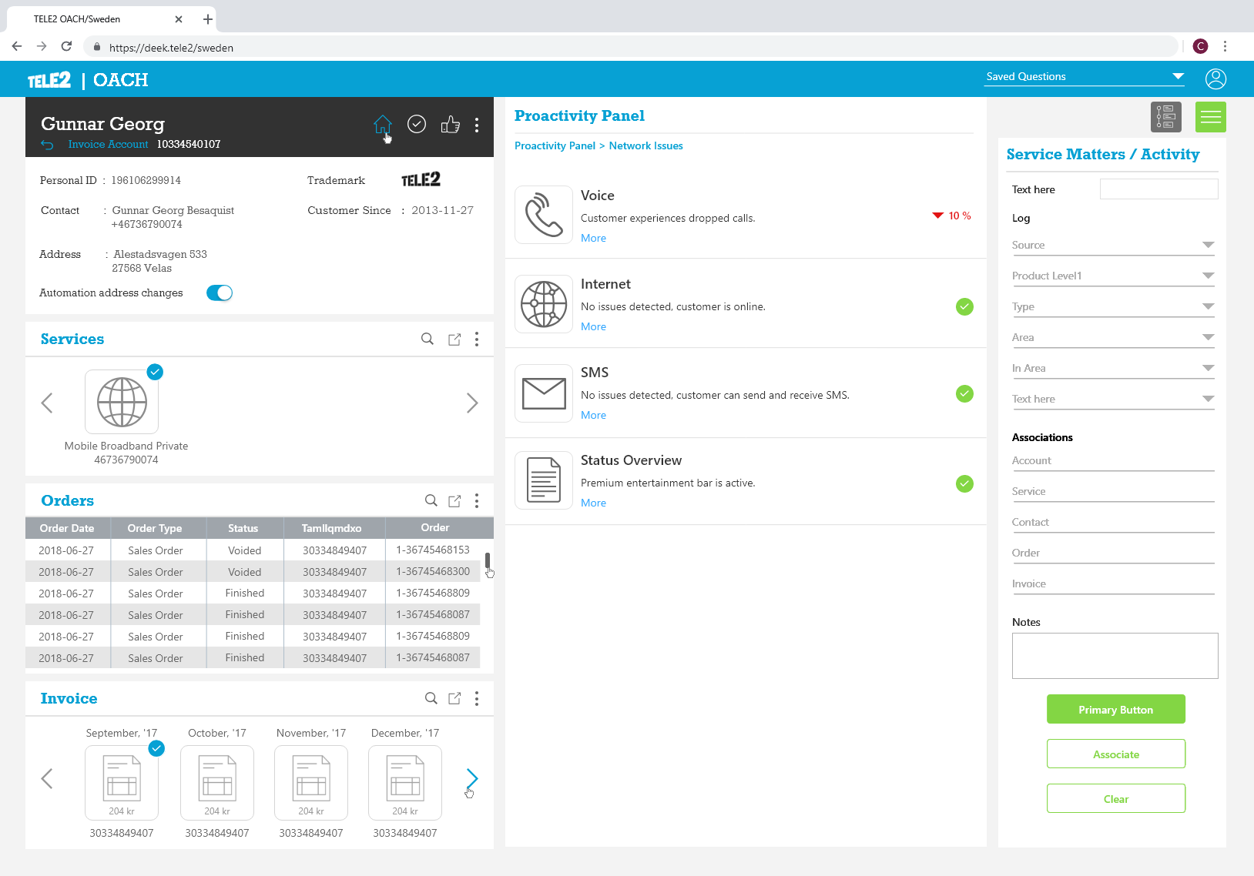

Slide 8
